Slide 1
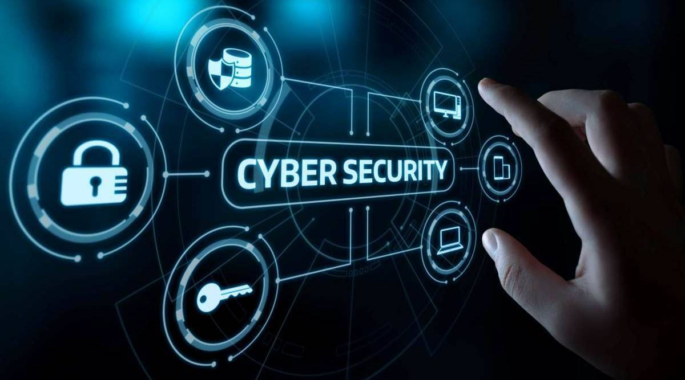
Security Policies and Procedures

Slide 2
What Is a Security Policy?

Slide 3
What Is a Security Policy?
Document that outlines protections to ensure organization’s assets face minimal risks
Higher level definition
Set of management statements that define organization’s philosophy of how to safeguard information
Lower level definition
Rules for computer access and how the rules are carried out

Slide 4
What Is a Security Policy? (cont’d.)
Security policy functions
Documents management’s overall intention and direction
Details specific risks and how to address them
Provides controls to direct employee behavior
Helps create a security-aware organizational culture
Helps ensure employee behavior is directed and monitored

Slide 5
Security Policies and Procedures

Slide 6
Security Policy Cycle
Risk Analysis
Asset Identification
Threat Identification
Vulnerability Appraisal
Risk Assessment
Security Policy Generation
Compliance Monitoring and Evaluation

Slide 7
Risk Analysis
First step in security policy cycle is to identify risks
Involves the four steps:
Inventory the assets
Determine what threats exist against the assets and by which threat agents
Investigate whether vulnerabilities exist that can be exploited
Decide what to do about the risks

Slide 8
Balancing Trust and Control
Three approaches to trust
Trust everyone all of the time
Trust no one at any time
Trust some people some of the time
Security policy attempts to provide right amount of trust
Trust some people some of the time
Builds trust over time
Level of control must also be balanced
The security needs and the culture of the organization play a major role when deciding what level of control is appropriate

Slide 9
Designing a Security Policy

Slide 10
Designing a Security Policy
Standard
Collection of requirements specific to the system or procedure that must be met by everyone
Example: Only fully patched laptops can connect to the network
Example: All computers must have antivirus software installed
Guideline
Collection of suggestions that should be implemented
Example: Wash your hands before eating
Policy
Document that outlines specific requirements or rules that must be met
Frequently refers to standards and guidelines
Example: All passwords must be 8 characters long as defined in the password standard.

Slide 11
Designing a Security Policy
Characteristics of a policy
Communicates a consensus of judgment
Defines appropriate user behavior
Identifies needed tools and procedures are needed
Provides directives for Human Resource action in response to inappropriate behavior
Helpful in the event that it is necessary to discipline or prosecute violators

Slide 12
Three phases of the security policy cycle
First Phase - Risk Management assessment
Asset identification
Threat identification
Vulnerability appraisal
Risk assessment
Risk mitigation
Second Phase - Create the policy using information from risk management study
Final Phase - Review the policy for compliance

Slide 13
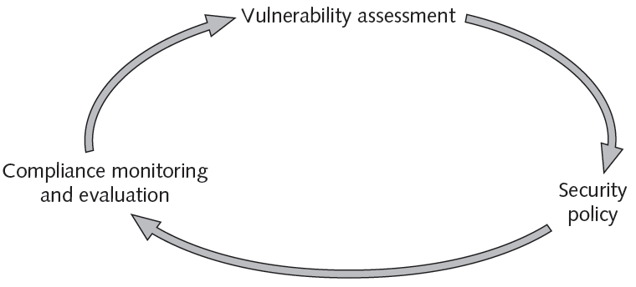
Figure 14-2 Security policy cycle
© Cengage Learning 2012

Slide 14
Asset Identification
Many different classes of assets.
Asset Identifiers:
Asset Name
Serial No.
Model No.
Dates of purchase / version
Anything that helps to uniquely identify the asset

Slide 15
Asset Identification (cont)
Relative Value of Asset:
How critical is this asset to the organization?
Is it a profit generator?
Is it a revenue generator?
What is its replacement cost?
What is its protection cost?
How long would it take to replace?

Slide 16
Threat Identification
Types of Threats:
Hardware failures
Acts of God
Human error
Theft
Sabotage
Compromise of Intellectual Property
etc.

Slide 17
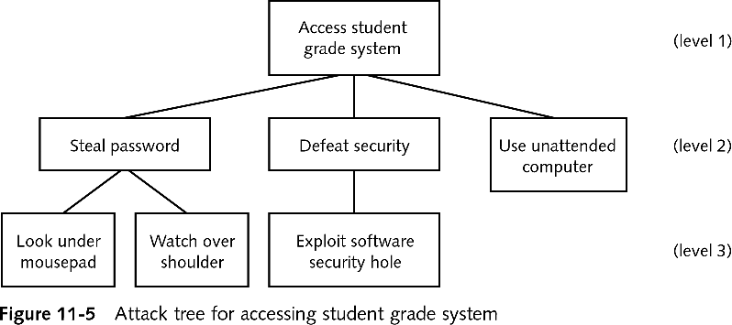
Attack Tree

Slide 18
Vulnerability Appraisal
To assist with determining vulnerabilities of hardware and software assets, use vulnerability scanners
Examples:
Nessus
nmap
etc.

Slide 19
Risk Assessment
No Impact
Small Impact
Significant Impact
Major Impact

Slide 20
Risk Assessment (cont)
Formulas commonly used to calculate expected losses are:
Single Loss Expectancy
Annualized Loss Expectancy
An organization has three options when confronted with a risk:
Accept the risk
Diminish the risk
Transfer the risk

Slide 21
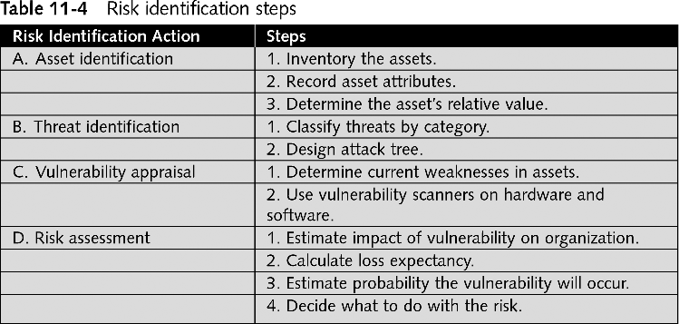
Risk Identification (Summary)

Slide 22
Designing a Security Policy?
A policy is a document that outlines specific requirements or rules that must be met
Has standard characteristics
Correct vehicle for an organization to use when establishing information security
A standard is a collection of requirements specific to the system or procedure that must be met by everyone
A guideline is a collection of suggestions that should be implemented

Slide 23
Balancing Control and Trust
To create an effective security policy, two elements must be carefully balanced: trust and control
Three models of trust:
Trust everyone all of the time
Trust no one at any time
Trust some people some of the time

Slide 24
Security Policies
Requirements:
Must be able to implement and enforce the policy
Must be concise and easy to understand
Must Balance protection with productivity
Recommendations
Should state reasons why the policy is needed
Should Describe what is covered by the policy
Should Outline how violations will be handled.

Slide 25
Security Policy Team
The team should have these representatives:
Senior level administrator
Member of management who can enforce the policy
Member of the legal staff
Representative from the user community

Slide 26
Types of Security Policies

Slide 27
Types of Security Policies
Most organizations have security (sub) policies that address:
Acceptable use policy
Privacy policy
Security-related human resource policy
Password management and complexity policy
Disposal and destruction policy
Service level agreements
Personally identifiable information
Classification of information policy
Ethics policy

Slide 28
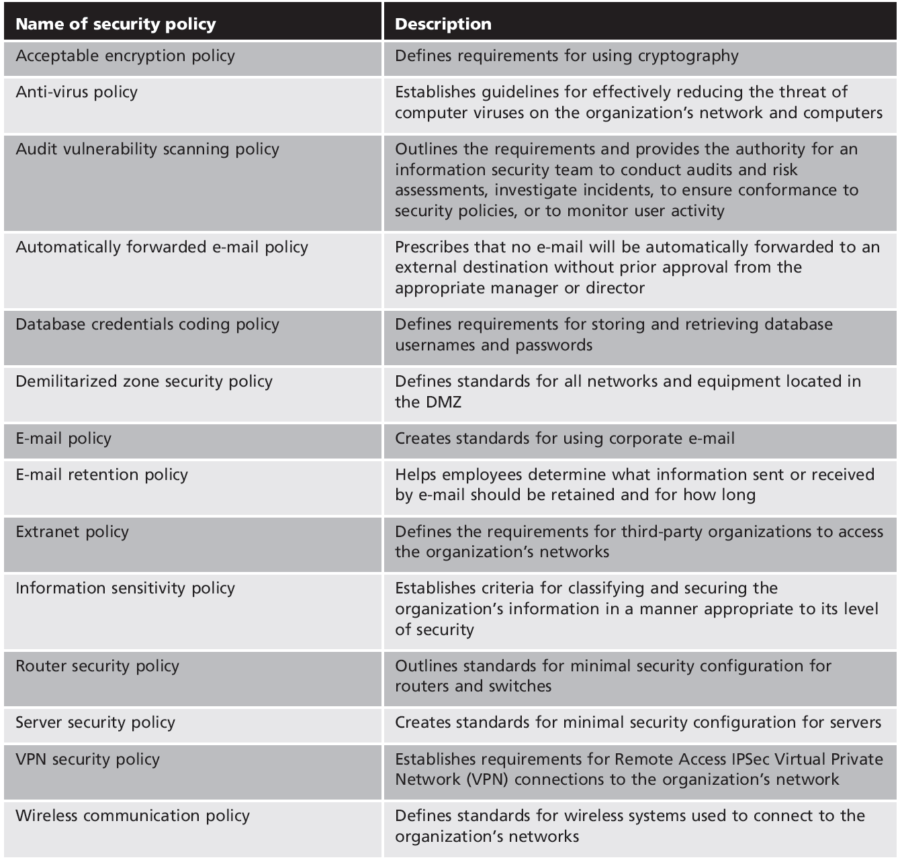
Table 14-3
Types of security policies

Slide 29
Acceptable use policy

Slide 30
Acceptable Use Policy (AUP)
Defines what actions users of a system may perform while using computing and networking equipment
Should have an overview regarding what is covered by this policy
Unacceptable use should also be outlined

Slide 31
Acceptable Use Policy (AUP)
Acceptable use policy
Policy that defines actions users may perform while accessing systems and the network
Users include employees, vendors, contractors, and visitors
Typically covers all computer use
Unacceptable use may also be outlined by the AUP
Acceptable use policies are generally considered to be the most important information security policies

Slide 32
Privacy Policy

Slide 33
Privacy Policy
Privacy is of growing concern among today’s consumers
Organizations should have a privacy policy that outlines how the organization uses information it collects

Slide 34
Privacy Policy
Privacy policy
Also called personally identifiable information policy
Outlines how organization uses personal information it collects

Slide 35
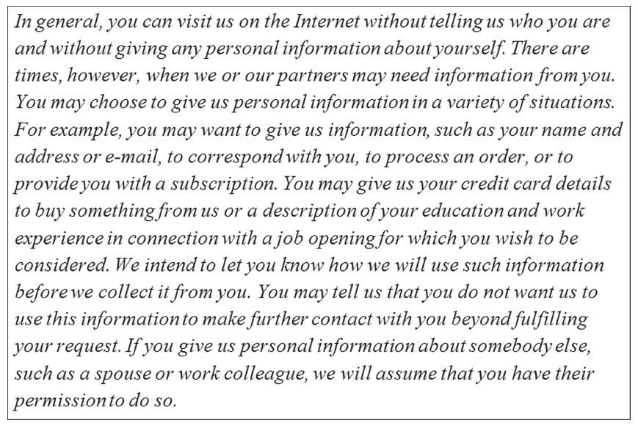
Figure 14-3 Sample privacy policy
© Cengage Learning 2012

Slide 36
Human Resource Policy

Slide 37
Human Resource Policy
Policies of the organization that address human resources
Should include statements regarding how an employee’s information technology resources will be addressed
When hired
When fired
For leave-of-absence
Temporary promotions or transfers

Slide 38
Security-related human resource policy
Information about technology resources
How resources are used
Acceptable use and security policies
Penalties for violating policies
Due process
Treating all accused persons in an equal fashion, using established rules and principles
Due diligence
Any investigation into suspicious employee conduct will examine all material facts
Typically presented at employee orientation session after employee is hired and may include statements regarding actions to be taken when employee is terminated

Slide 39
Password Management Policy

Slide 40
Password Management Policy
Password management and complexity policy
Addresses how passwords are created and managed
Reminds users of differences between strong and weak passwords

Slide 41
Password Management Policy
Although passwords often form the weakest link in information security, they are still the most widely used
A password management policy should clearly address how passwords are managed
In addition to controls that can be implemented through technology, users should be reminded of how to select and use passwords

Slide 42
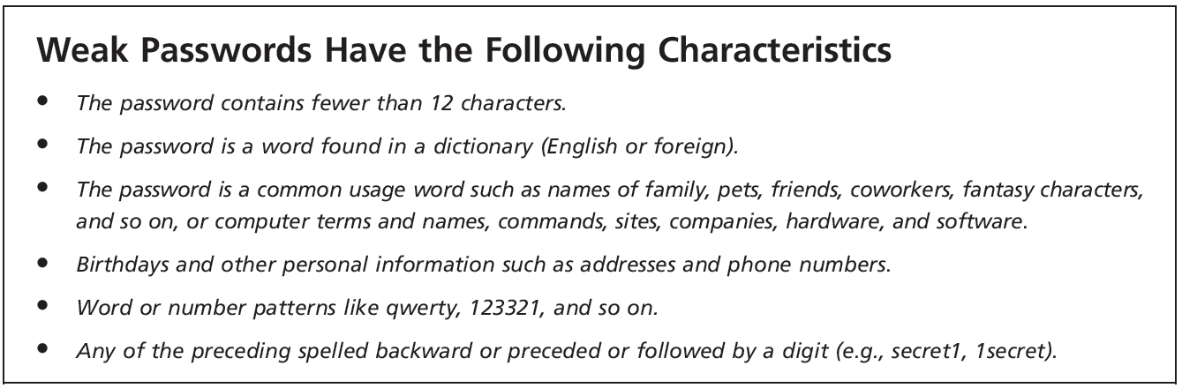
Figure 14-4 Weak password information
© Cengage Learning 2012

Slide 43
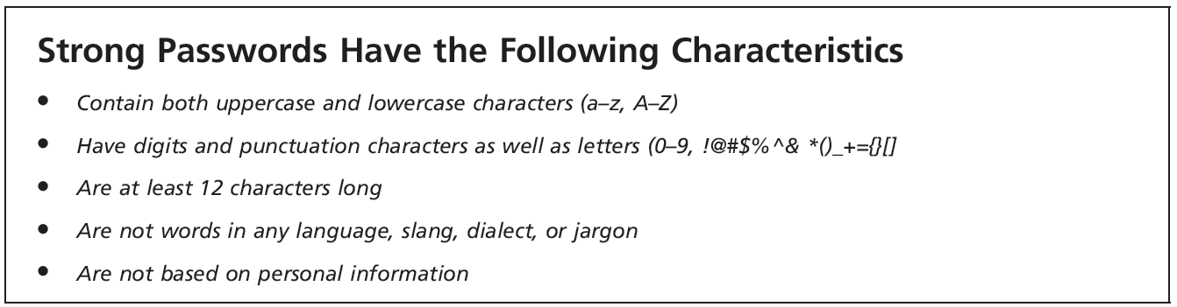
Figure 14-5 Strong password information
© Cengage Learning 2012

Slide 44
Data Policies

Slide 45
Data Policies
Data policies - Address different aspects of how data should be handled within an organization
Data storage policy - Set of procedures designed to control and manage data within organization by specifying data collection and storage
Data retention policy - Outlines how to maintain information in user’s possession for predetermined length of time
Data wiping and disposing policy - Addresses how and when data will ultimately be erased
Notes:
Data Policies
Data policies - Address different aspects of how data should be handled within an organization
Data storage policy - Set of procedures designed to control and manage data within organization by specifying data collection and storage
Data retention policy - Outlines how to maintain information in user’s possession for predetermined length of time
Data wiping and disposing policy - Addresses how and when data will ultimately be erased

Slide 46
Disposal and Destruction Policy

Slide 47
Disposal and Destruction Policy
Addresses disposal of confidential resources
Often covers how long records and data will be retained
Involves how to dispose of equipment, records, and data such as
Destroying hard drives
Proper disposal of sensitive documents

Slide 48
Disposal and Destruction Policy
A disposal and destruction policy that addresses the disposing of resources is considered essential
The policy should cover how long records and data will be retained
It should also cover how to dispose of them

Slide 49
Disposal and Destruction Policy
Vendor Supplied SSD wiping tools
University of California, San Diego, Non-Volatile Systems Laboratory found that those tools (and similar tools for flash-based devices such as thumb-drives) often did not work
http://cseweb.ucsd.edu/users/swanson/papers/Fast2011SecErase.pdf
NIST Guidelines for Media Sanitization
Recommendation for wiping varies media
http://csrc.nist.gov/publications/nistpubs/800-88/NISTSP800-88_with-errata.pdf

Slide 50
Disposal and Destruction Policy
Scramble and Finally Erase (SAFE)
1. Routinely use encryption to protect at least your most sensitive files (if not the whole drive).
2. Wipe the whole disk with a known-good tool when it's time to sell, scrap, or pass along your device.
http://cseweb.ucsd.edu/users/swanson/papers/TR-cs2011-0963-Safe.pdf

Slide 51
Ethics Policy

Slide 52
Ethics Policy
Codes of ethics by external agencies have encouraged its membership to adhere to strict ethical behavior within their profession
Codes of ethics for IT professionals are available from the Institute for Electrical and Electronic Engineers (IEEE) and the Association for Computing Machinery (ACM), among others
Main purpose of an ethics policy is to state the values, principles, and ideals each member of an organization must agree to

Slide 53
Ethics Policy
Written code of conduct
Guides employees in decision making
Serves as a communication tool to reflect organization’s commitments
Defining ethics can be difficult
An organization does not set an employee’s values
Does set ethical behavior standards

Slide 54
Ethics Policy
Values
A person’s fundamental beliefs and principles used to define what is good, right, and just
Morals
Values attributed to a belief system that helps individuals distinguish right from wrong
Ethics
The study of what a group of people understand to be good and right behavior and how people make those judgments

Slide 55
Ethics Policy
COD Faculty Ethics Policy
The Board of Trustees of Community College District 502 recognizes that there is a unique employer-employee relationship between the College and its employees and desires to promote and maintain an atmosphere of good will with its employees.
All employees will conduct themselves in accordance with all local, state and federal statutes, as well as all College of DuPage policies, procedures and regulations.

Slide 56
Threat Awareness
Peer-to-peer (P2P) networks
Similar to instant messaging
Users connect directly to each other
Typically used for sharing audio, video, data files
Tempting targets for attackers
Viruses, worms, Trojans, and spyware can be sent using P2P
Most organizations prohibit use of P2P
High risk of infection
Legal consequences

Slide 57
Threat Awareness (cont’d.)
Social networking
Grouping individuals based on some sort of affiliation
Can be physical or online
Web sites that facilitate social networking called social networking sites
Social networking sites carry risks:
Personal data can be used maliciously.
Users may be too trusting
Accepting friends may have unforeseen consequences
Social networking security is lax or confusing

Slide 58
Threat Awareness (cont’d.)
Security tips for using social networking sites
Consider carefully who is accepted as a friend
Show limited friends a reduced version of your profile
Users should be cautious about what information posted
Users should be cautioned regarding who can view their information
Users should be instructed to pay close attention to information about new or updated security settings
Disable options and then enable them only as necessary

Slide 59
Summary
A risk is the likelihood that a threat agent will exploit a vulnerability
Privilege management and change management are risk management approaches
A security policy states how an organization plans to protect its information technology assets
Development and maintenance of a security policy follows a three-phase cycle

Slide 60
Summary (cont’d.)
Security policies are often broken into subpolicies
Acceptable use policy
Privacy policy
Password management and complexity policy
Disposal and destruction policy
Classification of information policy
Awareness training provides users with knowledge and skills necessary to support information security

Slide 61
Thank You

